Slide 1
Step by step guide to setting up your fund raising page on JustGiving
v.1

Slide 2
The aim of this guide is to help you set up your fund raising
page on the website.
Before you start
Setting up a fund raising page will probably take about 10 minutes from start to finish.
It’s a good idea to have a photo of yourself ready to upload and to have a few words ready to put on your finished page describing what you are about to undertake and how much effort and pain it will cause you....all the better to generate sympathy for the cause and encourage the generosity of your friends, family and colleagues.
You will be part of a team, but with your own individual fund raising page.
Please, please ensure that you select NO to both the Gift Aid questions (see page 7). The costs of this ride are being covered by corporate sponsors and therefore all donations will be going to the charity.
Please remember to make the £195 donation to your personal page, to complete your registration. Do not enter any message when you do this.
It is normally a straight forward process, but if you have any problems with setting up a page, please let us know by emailing us on register@vegasafterparty.co.uk.

Slide 3
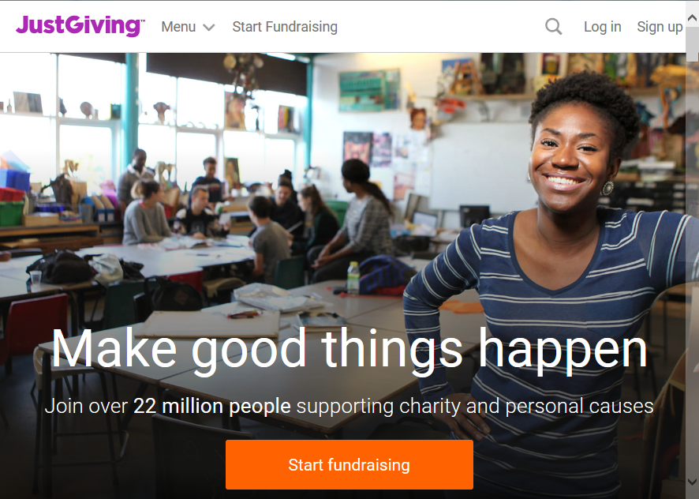
Firstly, go to www.justgiving.com and set up your own ‘personal’ account.
This is straight forward and sets you up for donating to events or participating. At this point you don't need to flag anything to do with the Vegas After Party.
If you raised money before using JustGiving, you do not need to create a new account, just Log in and go to Slide no. 3.
1

Slide 4
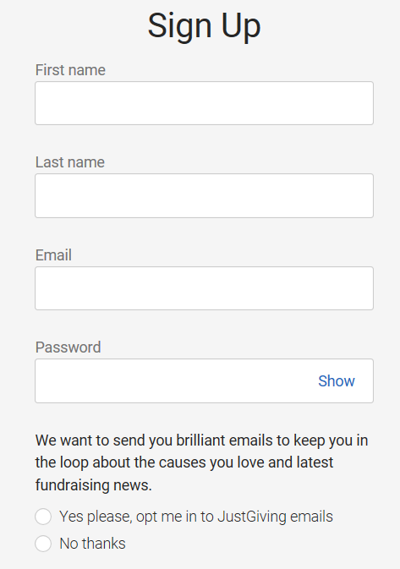
Signing up:
Complete your details and select whether you want to be bombarded with emails from JustGiving or not
2

Slide 5
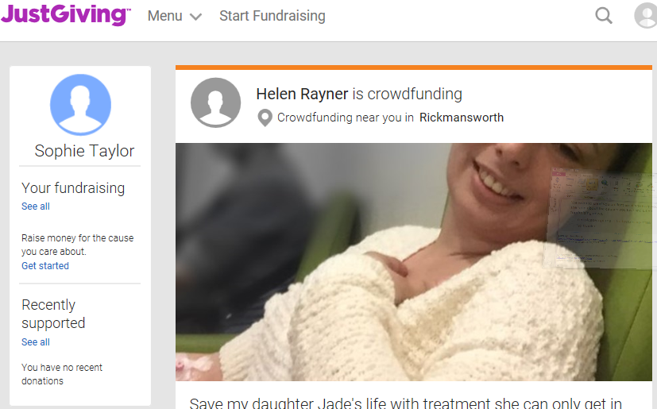
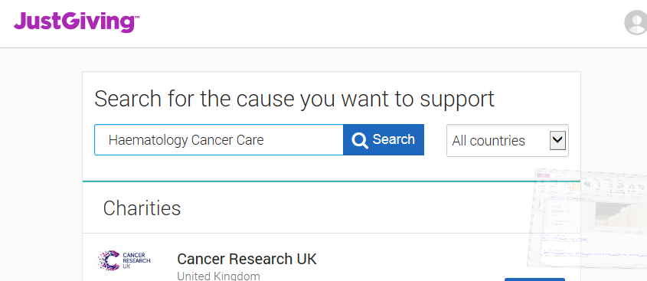
The first part is to create your fundraising page.
Select Start Fundraising and choose ‘A charity’. Click on Start fundraising and Complete profile with address etc.
Type ‘Haematology Cancer Care ’ into the Charity search field and click on Search and then select this Logo
3

Slide 6
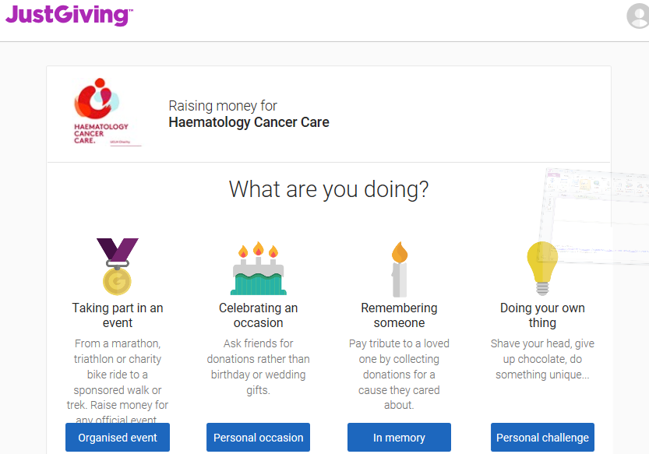
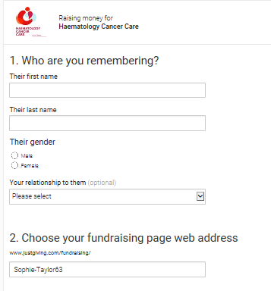
Complete as shown:
Select ‘Remembering someone’
and click ‘In memory’
Enter the details as follows:
Elias
Taylor
Male
Friend/Colleague/other
Fund Raising page web address: this will auto-populate or you can choose your own
Scroll down
4

Slide 7
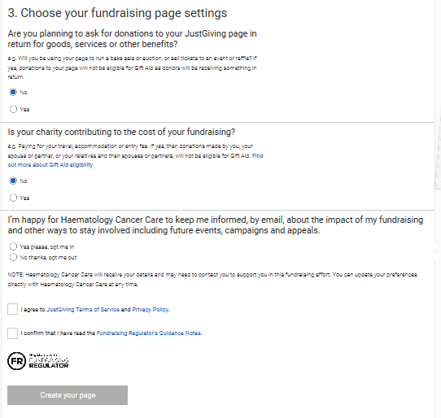
Complete fundraising settings
Please, please make sure you answer ‘No’ to both of these questions.
This question about future events is up to you
But you must agree to the 2 questions about Terms and Privacy
And then Create your page
5

Slide 8
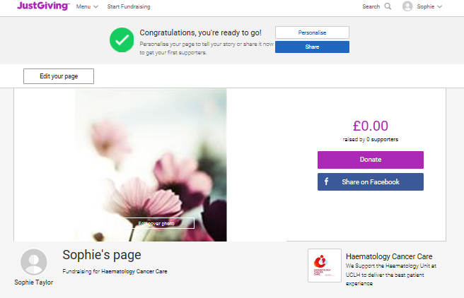
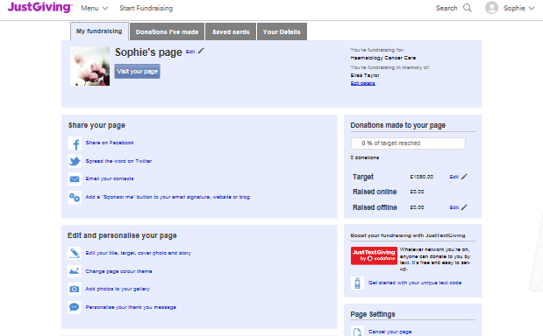
Now you need to start filling in some of the details about your involvement.
Select Edit your page
Page Title- you need to name your page
‘Vegas After Party’ or your name or whatever
And then Edit and Personalise your Page
6

Slide 9
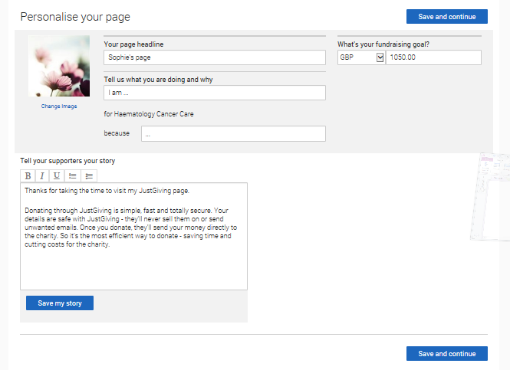
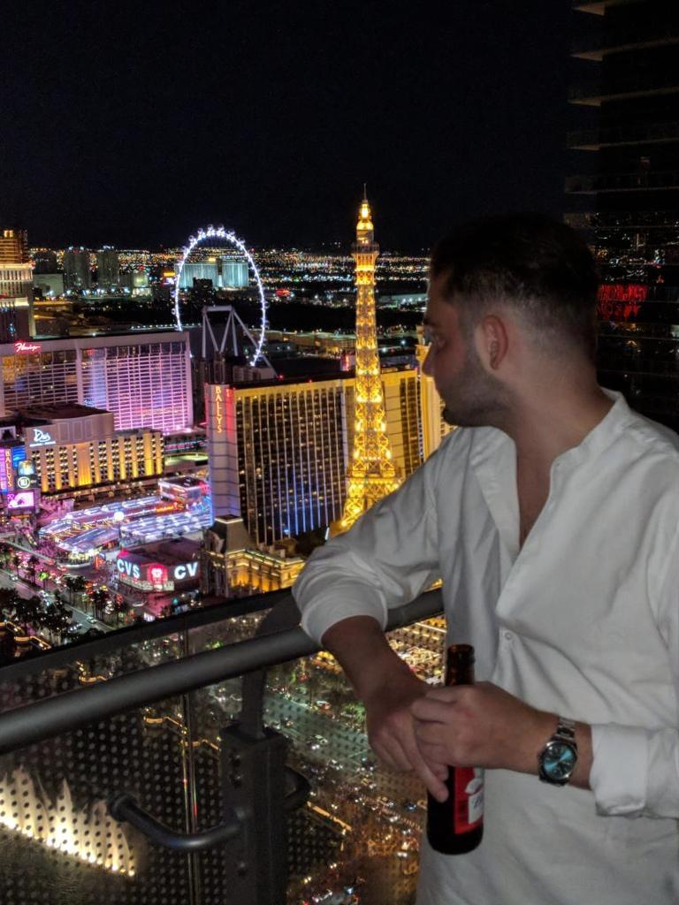
Choose your target fundraising amount. Remember that we require an initial donation of £195 to guarantee your place and we would like you to try and raise at least £1500 to achieve our targets for this event.
We would love you to raise as much as you can, so aim high and let people know your goal.
Offline donations can be entered at a later stage.
Upload some photos to show people what you look like and make your page stand out. Or you can enter this photo of Elias in Vegas
Tell your supporters your story-you can write what you like here or use the following text, tailored to you:
Elias was a 16 year old schoolboy when he was first diagnosed. He was a talented sportsman, enjoying rugby, football, tennis and golf, and despite his illness was the life and soul of every party. Elias beat his leukaemia three times and was lucky enough to have state of the art treatment at UCLH, which is a centre of excellence for haematology cancers.
In a few years’ time, research will have the answers that would have allowed Elias to beat his illness once and for all. Sadly, this is too late for this wonderful young man, but what a legacy it would be if we could fund the last bit of research that completes a vital piece of the jigsaw and makes dying of leukaemia a thing of the past.
We want to donate a substantial figure through a 3-day sponsored bike ride from Paris to London.
The money will go into a UCLH Haematology Research fund, but will be ring-fenced for this research project known as
The Elias Taylor Vegas After-Party.
Save and Continue
7

Slide 10
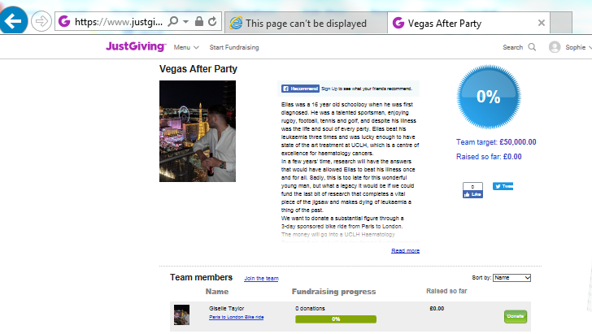
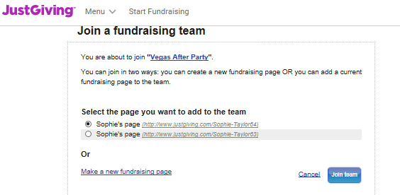
Now you need to link to the rest of the team:
Go to the Team Page:
http://www.justgiving.com/teams/VegasAfterParty
Click on Join the Team
Select your fundraising page
Confirm here
8

Slide 11
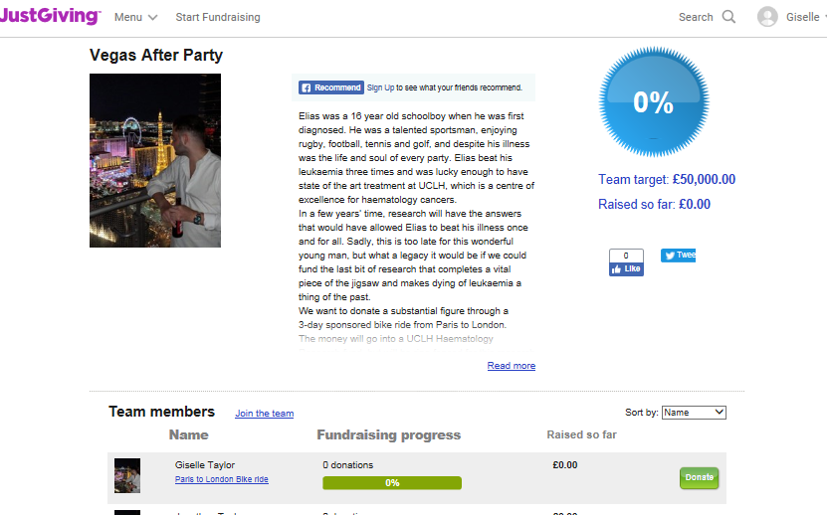
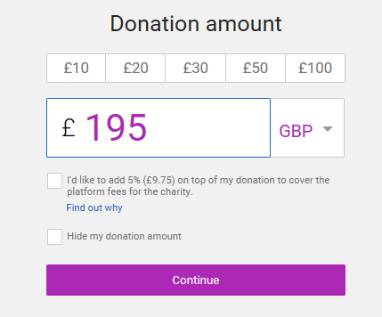
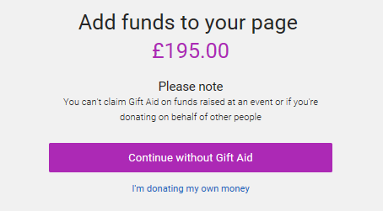
Donating to your page
Please donate £195 to your own page to guarantee your place.
Go to the Team Page at http://www.justgiving.com/teams/VegasAfterParty
Click on Donate
and complete as shown NB both boxes are unticked
And then ‘I'm donating my own money’
Do not write anything in the message box
Then confirm Gift Aid by ticking all 3 Statements and completing Tax Payer details.
9

Slide 12
That’s all there is to it, to set this up!
Fund Raising Tips:
Now that you have your fundraising site in place you are ready to broadcast your involvement with The Vegas After Party, as widely as possible. Use email, Facebook, LinkedIn, Twitter or any other network that you connect to. It is often surprising to see who reacts as sometimes you are unaware of other people’s connections to UCLH and Leukaemia.
Make sure that you include your page’s URL in any emails that you send out so that donors can easily find you on the website.
Use the information on the Vegas After Party flyer in your emails, to explain to people where the funds are going and the difference it will make to Leukaemia research.
Don’t be shy…people often don’t respond to emails on the first go, so aim to start fund raising early and get a new email out every month or so. Providing an update on your training is a great reason for sending out a new email.
Good luck and many thanks for joining The Vegas After Party 2019.
Any problems, just email us at register@vegasafterparty.co.uk

